Slide 1

Making this resource work for you
Prior to teaching this lesson, please refer to the ‘Unit Overview and Planning Document’.
Further guidance on planning Science Mastery lessons can be found in the detailed planning guidance document.
Refer to the ‘notes’ section on each slide for useful information, including suggested expositions, pedagogical content knowledge, suggested questions, answers and more. Consider using presenter mode so you can see this guidance throughout the lesson.
The introduction slides can be adapted to suit your teaching style and the needs of your class.
Before the lesson, adapt the fix-it slide to address any misconceptions identified in the previous lesson’s exit ticket.
Choose from the suggested activities to suit your class. The intention is not that you complete all of these, but that you select those which ones are most appropriate for your students. It may be appropriate to further adapt activities for your students.
These lessons are designed to occupy approximately 1 hour. To adapt for a shorter or longer lesson duration we advise you to adapt the activity section accordingly.
Please consider using the final slide to send feedback about this lesson or examples of PowerPoints that you have adapted to our design team. Your feedback is used to improve Science Mastery for all of our teachers and students. We appreciate all suggestions and comments.
Thank you for reading!
The Science Mastery Team

Slide 2
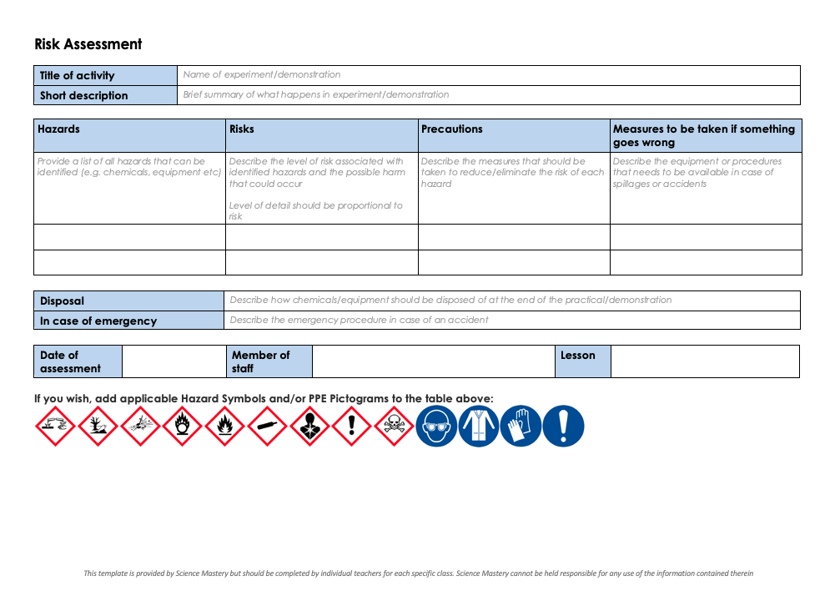
Practical Activity
This lesson contains a practical activity (either a whole class activity or a demonstration)
A risk assessment must be completed for this practical
The template risk assessment can be found here.
The risk assessment should be specific to the class involved and written only by the teaching member of staff
The risk assessment should refer to the current CLEAPSS Hazcards for all chemicals used in the practical for safety and disposal notes.
A list of chemicals used can be found in the Practical Guide
It is good practice for students to wear safety spectacles during all class practicals and demonstrations
Thank you for reading!
The Science Mastery Team

Slide 3

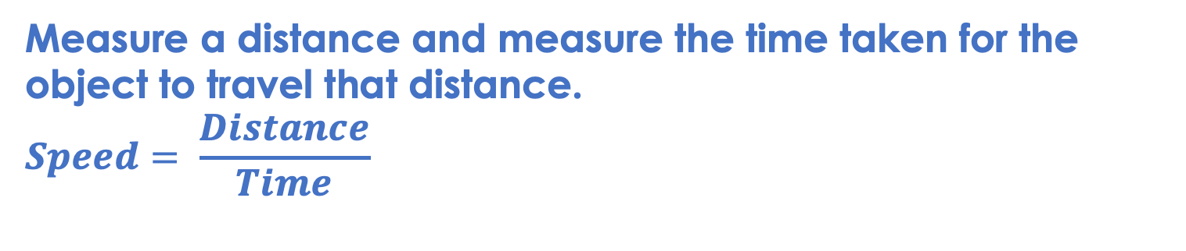
Acceleration Investigation
Answer the following questions:
Define acceleration.
State the SI unit for acceleration.
State the equation used to calculate acceleration.
Explain the difference between speed and velocity.
Describe how to calculate the speed of an object.
The rate of change of velocity.
Metres per second squared (m/s²)
$$Acceleration= \frac{Change in velocity}{Time}$$
Speed is the distance covered per unit time and is a scalar quantity, whereas velocity is a vector and is speed in a given direction.
Measure a distance and measure the time taken for the object to travel that distance.
$$Speed= \frac{Distance}{Time}$$
Notes:
Foundation question: State the SI units for speed, distance and time.
Answer: Speed: m/s, distance: m, time: s
Stretch question: Describe the information you would need to be able to measure the acceleration of an object.
Answer: You would need initial velocity, final velocity and the time taken for the acceleration.

Slide 4
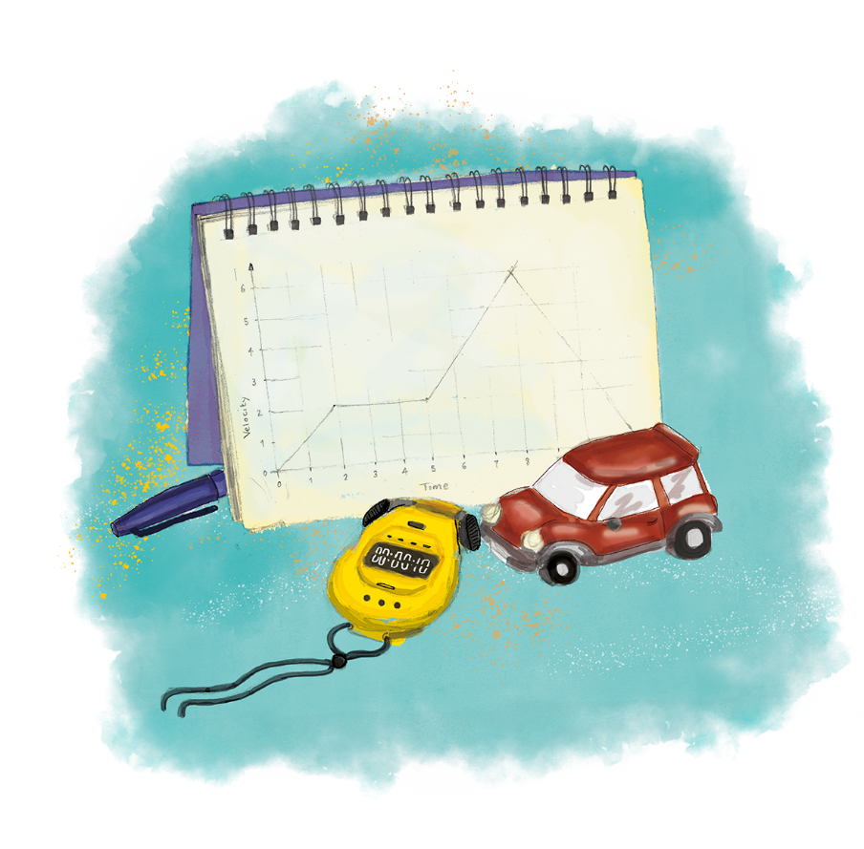


P3.1.8
01/05/2024
Acceleration Investigation
P3.1.1 Prior Knowledge Review
P3.1.2 Scalars and Vectors
P3.1.3 Resultant Vectors
P3.1.4 Resolving Vectors
P3.1.5 Newton's Third Law
P3.1.6 Newton's First Law
P3.1.7 Acceleration
P3.1.8 Acceleration Investigation
Maths in Science Lesson 17
P3.1.9 Velocity-Time Graphs
P3.1.10 Velocity-Time Graphs 2
P3.1.11 Acceleration Problems
Notes:
Pupils have been introduced in the previous lesson to acceleration as the rate of change of velocity. In this lesson they will learn to measure the acceleration of an object. This will then lead into velocity-time graphs and identifying and calculating acceleration from velocity-time graphs.
Hook:
How could you measure the acceleration of an object? What measurements would you need to take?

Slide 5

Following this lesson, students will be able to:
Measure the final and initial velocity of an object.
Calculate acceleration from an experiment.
Identify anomalous results.
Key Words:
force
acceleration
velocity
initial
final
anomalous

Slide 6
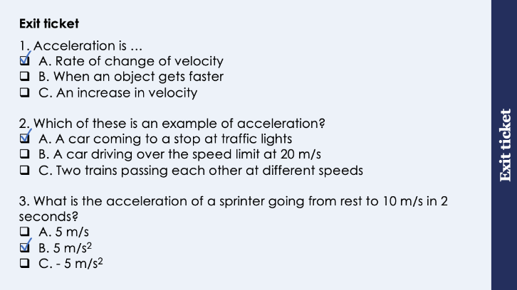
This is the fix-it portion of the lesson
The fix-it is an opportunity to respond to gaps in knowledge, especially those identified by the previous lesson’s exit ticket.
The teacher should customise this slide as needed, to facilitate
reteach, explanation, demonstration or modelling of ideas and concepts that students have not yet grasped or have misunderstood.
practise answering specific questions or of key skills.
redrafting or improving previous work.
Notes:
Suggested Guidance from previous exit ticket:
Q1. Answer: A
If students answered B or C they have the common misconception that acceleration only refers to an increase in speed or velocity. To fix-it, it may be useful to give pupils further scenarios of objects slowing down or changing direction as examples of acceleration.
Q2. Answer: A
If students answered B they have confused speed and acceleration. If students answered C they have confused the idea of acceleration with relative motion. To fix-it, it may be useful to revisit the changing speeds lesson from P2.1 where pupils identify whether objects are changing speed or not.
Q3. Answer: B
If students answered A they have correctly calculated acceleration but have chosen the wrong unit. If students answered C they have taken their initial and final velocities incorrectly. To fix-it, practice further examples of acceleration calculations, with both positive and negative accelerations.

Slide 7

How many links can you make between forces and acceleration?
Are they scalar or vector quantities?
What are the units for each?
If an object is accelerating, what can be said about the forces acting on it?
If an object is not accelerating (it is stationary or at a constant velocity), what can be said about the forces acting on it?
Notes:
Guidance:
Quick recap to get pupils thinking about the relationship between force and acceleration.
Suggested guidance:
Talk tasks can be used in a variety of ways to suit the particular needs of the students you are teaching. Through exchanging views with others, students develop their understanding of the science beyond what could be achieved individually.
Science classrooms that successfully integrate talk have the following features:
Science talk is a regular feature of lessons and is woven into classroom activities.
Students are paired or grouped strategically by the teacher to ensure productive interaction. This might take into consideration the students’ proficiency of the English language, how encouraging they might be to peers and their attainment in the topic. It’s a good idea to consider these pairings in the class seating plan.
Students are encouraged and supported to talk, but are not forced to talk.
The teacher should take on the role of a facilitator, engaging with conversations where necessary and encouraging or steering the conversation where needed.
Students are encouraged to use the language they have to express their ideas (e.g., everyday language, imperfect English, native language), but also to incorporate science specific terminology where this is more accurate or has been taught.
6. Scientifically inaccurate ideas are not dismissed by the partner or teacher; open discussion and further investigation are relied on to help students construct ideas that support them to progress in their scientific understanding.
7. Guidelines for behaviour during talk tasks are explicit and frequently reviewed. Rules for students might be:
Listen carefully to your partner
Take turns talking.
Speak one at a time, without interrupting.
Politely agree or disagree and explain why.
Politely point out if your partner has used a scientific word incorrectly, if they have explained the science incorrectly, or if there is a more accurate way to describe something.
If confused, ask questions.
Stay focused on the discussion topic.
Respond to one another.

Slide 8
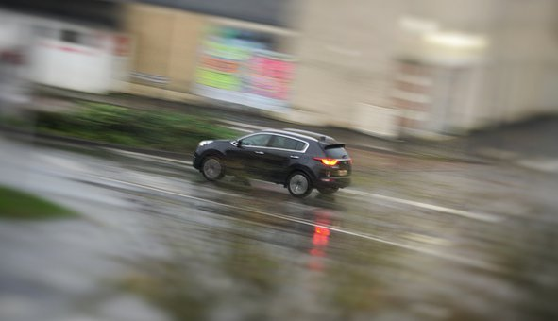
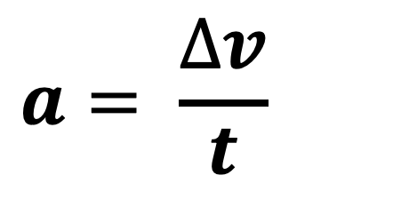
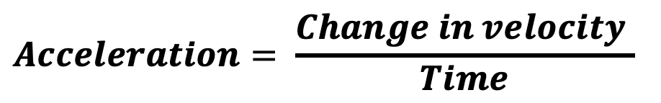
Acceleration
Acceleration is the rate of change of velocity.
$$Acceleration= \frac{Change in velocity }{Time}$$
To calculate the acceleration of an object we need to know its initial velocity, its final velocity and the time taken for the velocity to change.
Velocity is speed in a given direction.
$$a= \frac{∆v}{t}$$
Notes:
Exposition type: explanation
Suggested exposition:
Acceleration is the rate of change of velocity so to be able to calculate the acceleration of an object we need to know how much the velocity changed by and how long this took. This means we need to record the initial velocity, the final velocity and the time taken for the velocity to change.
Velocity is speed in a given direction so if we use all our velocities in the same direction (i.e. forwards) we can simply use speed as the measurement for velocity.
How can we calculate speed?
Speed = distance/time. Measure a distance and the time taken for an object to cover this distance.
Therefore to calculate velocity we can use distance/time because it will always be going in the same direction (forwards)
Notes:
This is Required Practical 19 (combined Science) and 7 (Physics only)
It is the practical for Newton’s second law but it is using the practical application of measuring acceleration so it can be included in this unit and then referred to later on in P4.1, as that is a heavy practical unit.
Image source: pixabay

Slide 9
Anomalous Results
Anomalous results are results that do not fit the pattern.
If they are caused by experimental error, they should be ignored when calculating a mean.
The following measurements were taken before calculating the acceleration of a toy car. Students carried out 4 trials using the same car and recorded the initial and final velocity in each trial.
Trial | Initial Velocity | Final Velocity
1 | 0 m/s | 1 m/s
2 | 0 m/s | 1.5 m/s
3 | 0 m/s | 1 m/s
4 | 0 m/s | 6 m/s
Mean
Which is the anomalous result?
What should we do when calculating the mean?
6 m/s
The anomalous result should be ignored before calculating the mean.
0 m/s
1.17 m/s
Notes:
Exposition type: explanation
Suggested exposition:
(Pupils have already looked at anomalous results so this refresher can be relatively quick.)
Anomalous results are ones results that do not fit the pattern, meaning that they are significantly different from the other results. If they are caused by experimental errors, such as poor or inaccurate measurements, they should be ignored when calculating a mean.
These measurements were taken during the same experiment that we are about to do, looking at the acceleration of a toy car. This group of students took four measurements, using the same toy car each time and measured the initial and final velocity each time.
What is the anomalous result? How do you know this?
6 m/s. This is anomalous because it does not fit the pattern of the rest of the results - it is clearly different.
What should we do when calculating the mean?
Ignore the anomalous result and use the other values to calculate the mean.
Calculate the mean initial velocity and the mean final velocity of the toy car.
The anomalous result would be ignored when calculating the mean. The mean initial velocity would be (0+0+0+0)/4 = 0 because there are no anomalous results here.
The mean final velocity would be (1+1.5+1)/3 = 1.17 m/s because the anomalous result has been ignored.
What is wrong with these values for velocity?
They do not have a stated direction and velocity is a vector quantity. For the purpose of this experiment we can take our direction to always be ‘forwards’.
Stretch: suggest the error that could have caused pupils to get this result.
Answer: most likely an error was made with measurement of time.

Slide 10
Quick Quiz:
What values do you need to be able to calculate acceleration?
What values do you need to be able to calculate speed?
What is the difference between speed and velocity?
What is an objects initial velocity if it starts from rest?
Initial velocity, final velocity and time taken
Distance and time
Velocity has a direction, speed does not.
0 m/s
Notes:
Purpose: review of new information.
MWBs/in books
initial velocity, final velocity and time taken
distance and time
velocity has a direction
0 m/s

Slide 11
Drill
What is velocity?
What is acceleration?
What are the quantities needed to calculate acceleration?
What is initial velocity?
What are the two quantities needed to find velocity?
What is an anomaly?
If an anomaly occurs, what should you do with this value?
Students measured the time taken for a toy car to travel 1 m. Their results were: 2.5 s, 2.4 s, 2.8 s and 2.5 s. Which number is the anomaly?
Calculate a mean for the following accelerations: 6.2 m/s², 6.7 m/s², 6.6 m/s², 6.7 m/s², 6.6 m/s²
Notes:
Purpose: This is a knowledge drill. The purpose of this is to check that the critical knowledge is secure before pupils move onto independent practice.
Suggested guidance: There are a range of ways this could be done depending on time and ability range of the class:
Mini whiteboards
As full sentences in exercise books
As short answers in exercise books
In the pupil workbook
As pair talk
As cold call

Slide 12
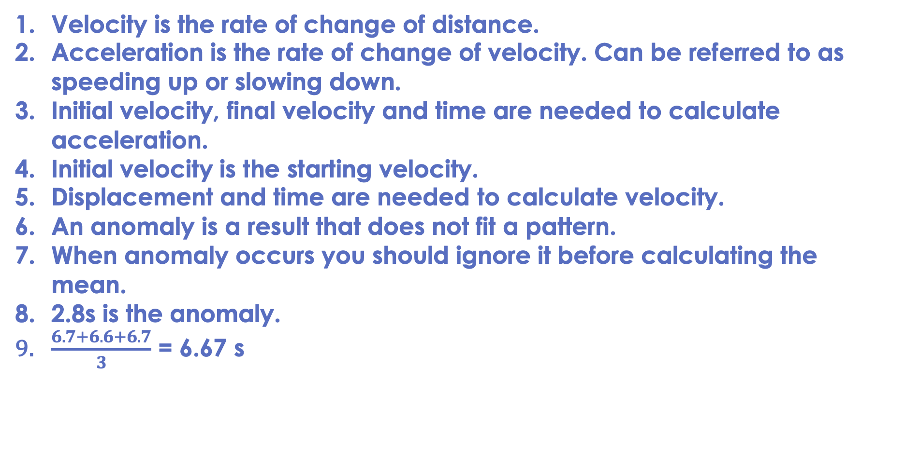
Drill answers
Velocity is the rate of change of distance.
Acceleration is the rate of change of velocity. Can be referred to as speeding up or slowing down.
Initial velocity, final velocity and time are needed to calculate acceleration.
Initial velocity is the starting velocity.
Displacement and time are needed to calculate velocity.
An anomaly is a result that does not fit a pattern.
When anomaly occurs you should ignore it before calculating the mean. 2.8s is the anomaly.
$\frac{6.7+6.6+6.7}{3}$ = 6.67 s
Notes:
Purpose: This is a knowledge drill. The purpose of this is to check that the critical knowledge is secure before pupils move onto independent practice.
Suggested guidance: There are a range of ways this could be done depending on time and ability range of the class:
Mini whiteboards
As full sentences in exercise books
As short answers in exercise books
In the pupil workbook
As pair talk
As cold call

Slide 13
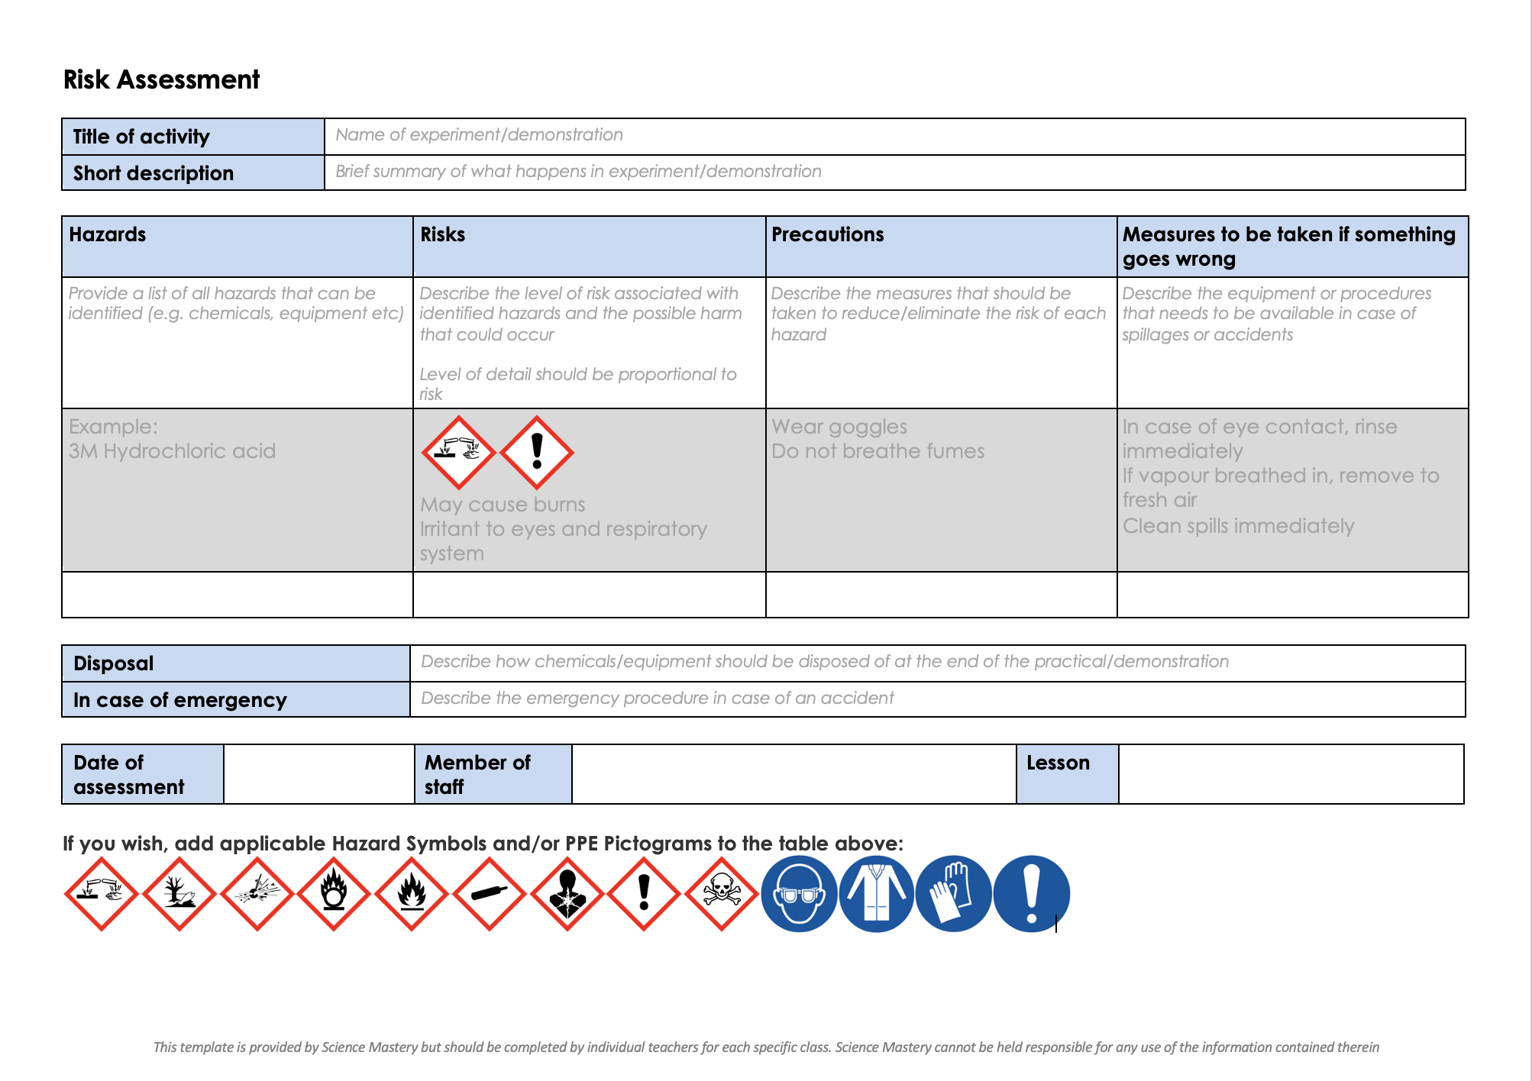
Risk Assessment
A risk assessment must be completed for this practical
The template risk assessment can be found here.

Slide 14
Acceleration Investigation
Follow the instructions to complete the acceleration investigation
Complete the tables
Show all working when calculating acceleration
Ensure you include units and remember to convert into SI units where necessary
Notes:
Purpose: skills practice
The skills focus of this investigation is on measuring time accurately using a stopwatch, measuring acceleration and identifying anomalous results.
The different variables are included so that pupils have repeated practice of calculating acceleration and measuring time.
Teacher guidance provided in technician practical guide, including expected results. At this point the focus is on measuring the acceleration, rather than the relationship F = ma so graph is not included as this point.
You may want to add in scaffolding for pupils that would find it useful, such as highlighting where they can find initial velocity and final velocity. It may also help to show them a video of a ticker timer in action.
You may also want to simplify and just do force or mass as the independent variable, rather than both.
Measurements and calculations are quite time consuming but time permitting you may want to get pupils to identify dependent/independent/control variables for each experiment.
Calculation guidance:
Initial velocity is 0 m/s each time as the toy cars are starting from rest
Final velocity can be calculated during the last interval (from 80 to 100 cm) using distance/time: 0.2m/time taken to travel the last 20 cm only.
Acceleration = (final velocity – initial velocity)/total time
Total time taken is the whole time taken from 0 to 100 cm.
It may be useful to do a worked example for the first value in each column so that pupils have a structure to follow.
Expected conclusions:
Experiment 1 – as force increases, acceleration also increases (directly proportional)
Experiment 2 – as mass increases, acceleration decreases (inversely proportional)

Slide 15

I: Describe: to recall facts, events or processes in an accurate way
Example question:
Describe how to use initial and final velocity to measure acceleration of an object.
To ‘describe’, your answer should:
Use bullet points.
Include each step of the process in a logical order.
Use keywords throughout the answer
Stay focused on the question.
Model answer:
Acceleration is the rate of change of velocity.
This means we need to measure how much the velocity changes by and how long this takes
We can measure the initial speed of an object by measuring a distance and timing how long it takes the object to cover this distance, then use speed = distance/time
We can measure the final speed in the same way
Change in velocity is the difference between the final speed and the initial speed in a given direction
We can measure the time taken for the change in velocity
Finally, we can calculate acceleration using acceleration = change in velocity/time
Notes:
This slide models the process of answering a describe question.
Firstly, students are presented with a generic describe question, along with a model answer. Students are also given some simple guidance to follow for producing their own describe answer.
The generic question and answer should be used by the teacher to remind students of
the key features of a great answer
how to structure their answer
why the model answer is a good example
Following this, students will be required to apply this process to answer their own describe question, which will appear in place of the generic questions. This describe question will be specific to the topic students are learning about in the lesson. Give students time to write their own answer to this, ensuring that they use the guidance provided. To further scaffold this task for students, it may be appropriate to:
pair students up to write an answer together
list for students the key words you would like them to include in the answer
provide a writing frame or ‘points to include’ for students
A model answer for this question will appear. Teachers should review the model answer with students by referencing the guidance in the green box. For example ‘we can see item 1 in the guidance is to use bullet points to keep your answer clear. Notice in the model answer here we have done just that’. Or ‘item 2 in the guidance here says that we should use scientific keywords in the answer. Has this been achieved in the model answer? Where can we see this?’.

Slide 16
We: Describe: to recall facts, events or processes in an accurate way
Example question:
Describe how to measure velocity.
To ‘describe’, your answer should:
Use bullet points.
Include each step of the process in a logical order.
Use keywords throughout the answer
Stay focused on the question.
Model answer:
Velocity is speed in a given direction
This means we need to measure speed and determine the direction
We can use speed = distance/time
The velocity must be written with a direction
Notes:
This slide models the process of answering a describe question.
Firstly, students are presented with a generic describe question, along with a model answer. Students are also given some simple guidance to follow for producing their own describe answer.
The generic question and answer should be used by the teacher to remind students of
the key features of a great answer
how to structure their answer
why the model answer is a good example
Following this, students will be required to apply this process to answer their own describe question, which will appear in place of the generic questions. This describe question will be specific to the topic students are learning about in the lesson. Give students time to write their own answer to this, ensuring that they use the guidance provided. To further scaffold this task for students, it may be appropriate to:
pair students up to write an answer together
list for students the key words you would like them to include in the answer
provide a writing frame or ‘points to include’ for students
A model answer for this question will appear. Teachers should review the model answer with students by referencing the guidance in the green box. For example ‘we can see item 1 in the guidance is to use bullet points to keep your answer clear. Notice in the model answer here we have done just that’. Or ‘item 2 in the guidance here says that we should use scientific keywords in the answer. Has this been achieved in the model answer? Where can we see this?’.

Slide 17
You: Describe: to recall facts, events or processes in an accurate way
Example question:
Describe how to measure acceleration.
To ‘describe’, your answer should:
Use bullet points.
Include each step of the process in a logical order.
Use keywords throughout the answer
Stay focused on the question.
Model answer:
Acceleration is the rate of change of velocity.
This means we need to measure how much the velocity changes by and how long this takes
We can measure the initial velocity and the final velocity
Change in velocity is the difference between the final speed and the initial speed in a given direction
We can measure the time taken for the change in velocity
Finally, we can calculate acceleration using acceleration = change in velocity/time
Notes:
This slide models the process of answering a describe question.
Firstly, students are presented with a generic describe question, along with a model answer. Students are also given some simple guidance to follow for producing their own describe answer.
The generic question and answer should be used by the teacher to remind students of
the key features of a great answer
how to structure their answer
why the model answer is a good example
Following this, students will be required to apply this process to answer their own describe question, which will appear in place of the generic questions. This describe question will be specific to the topic students are learning about in the lesson. Give students time to write their own answer to this, ensuring that they use the guidance provided. To further scaffold this task for students, it may be appropriate to:
pair students up to write an answer together
list for students the key words you would like them to include in the answer
provide a writing frame or ‘points to include’ for students
A model answer for this question will appear. Teachers should review the model answer with students by referencing the guidance in the green box. For example ‘we can see item 1 in the guidance is to use bullet points to keep your answer clear. Notice in the model answer here we have done just that’. Or ‘item 2 in the guidance here says that we should use scientific keywords in the answer. Has this been achieved in the model answer? Where can we see this?’.

Slide 18
Answer the questions below.
1. What was the dependent variable in this experiment?
A. Force applied
B. Mass of the car
C. Acceleration
2. Acceleration can be calculated by…
A. Change in velocity divided by time
B. Distance divided by time
C. Velocity divided by time
3. An object accelerates from rest to 10 m/s in two seconds. What is its initial velocity?
A. 2 m/s
B. 10 m/s
C. 0 m/s
✓
✓
✓
Notes:
Suggested Guidance:
Q1. Answer: C
If students answer A or B, they are still not secure on the difference between independent and dependent variables. To fix-it, you may want to revisit earlier skills lessons on variables to get pupils to identify dependent and independent variables from investigation titles.
Q2. Answer: A
If students answer B, they have confused acceleration and speed. If students answer C, they are closer but have missed the crucial detail of change in velocity. To fix-it, get pupils to explain how you calculate the change in a quantity and how this applies to acceleration.
Q3. Answer: C
If students answer A, they have taken the time as the initial velocity and if students answer B, they have taken final velocity as the initial velocity. To fix-it, model further examples with pupils, highlighting or underlining the quantities from the question.

Slide 19
Lesson P3.1.8
What was good about this lesson? | What can we do to improve this lesson?
Send us your feedback by clicking this link
or by emailing sciencemastery@arkonline.org
Thank you!

